Slide 1
ANUDIP
PROJECT REPORT
ON
ANALYTICS
BY THE TEAM
- GUNDI SRIYA MANASA
- JOSHNA SATWIKA KOPPISETTI
-HARSHITH KAKANI
-PRIYA THAPA
-P.RASAGNA
- LAKSHMI PRASANNAJALI
-GUNDETI SHIREESHA
-VINUTHNA MUDDAM

Slide 2
PART 1
Expense details for June

Slide 3
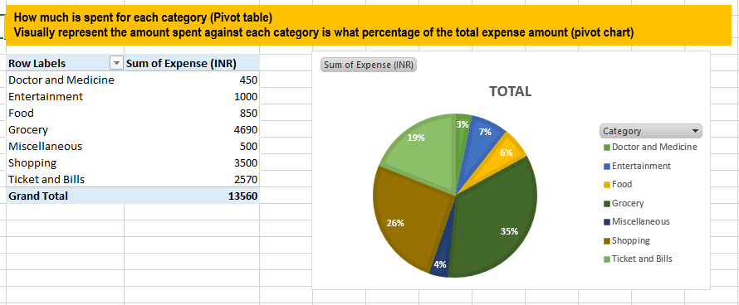
TASK 1
How much is spent in each category and visually represent the data in percentages using a pivot chart .

Slide 4
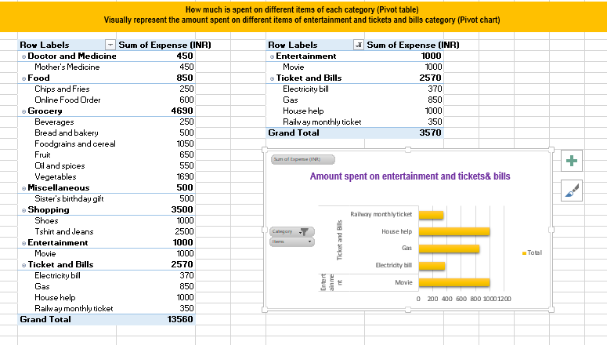
TASK 2
How much is spent on different items of each category (pivot table ) and visually represent the amount spent on different items of entertainment and tickets and bills category (pivot chart)

Slide 5
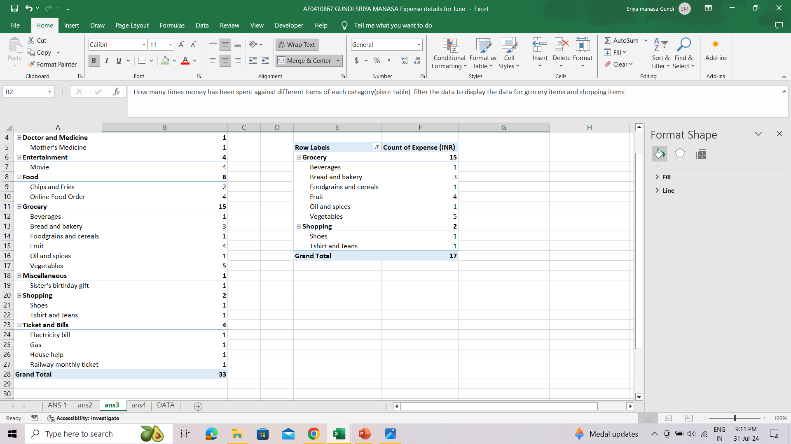
TASK 3
How many times money has been spent against different items of each category(pivot table) filter the data to display the data for grocery items and shopping items .

Slide 6
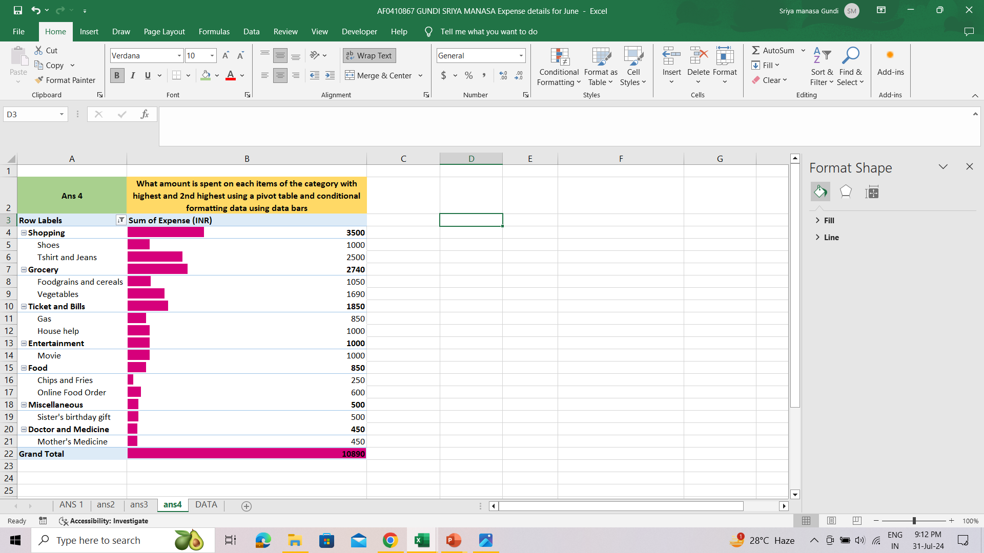
TASK 4
What amount is spent on each items of the category with highest and 2nd highest using a pivot table and conditional formatting data using data bars.

Slide 7
PART 2
Expense details for the six months

Slide 8
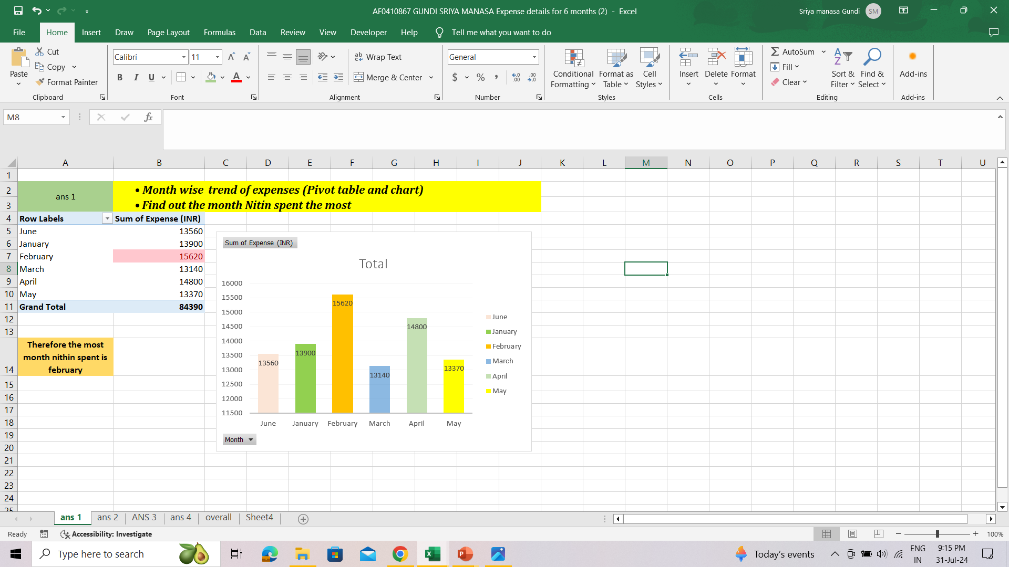
TASK 1
Member 1 | Month-wise trend of expenses (Pivot table and chart) Find out the month Nitin spent the most

Slide 9
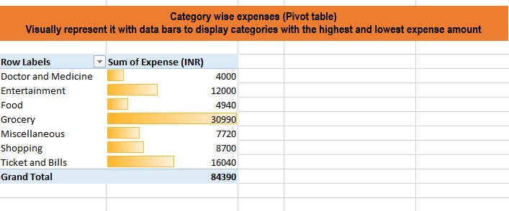
TASK 2
Member 2 | Category wise expenses (Pivot table) Visually represent it with data bars to display categories with the highest and lowest expense amount

Slide 10
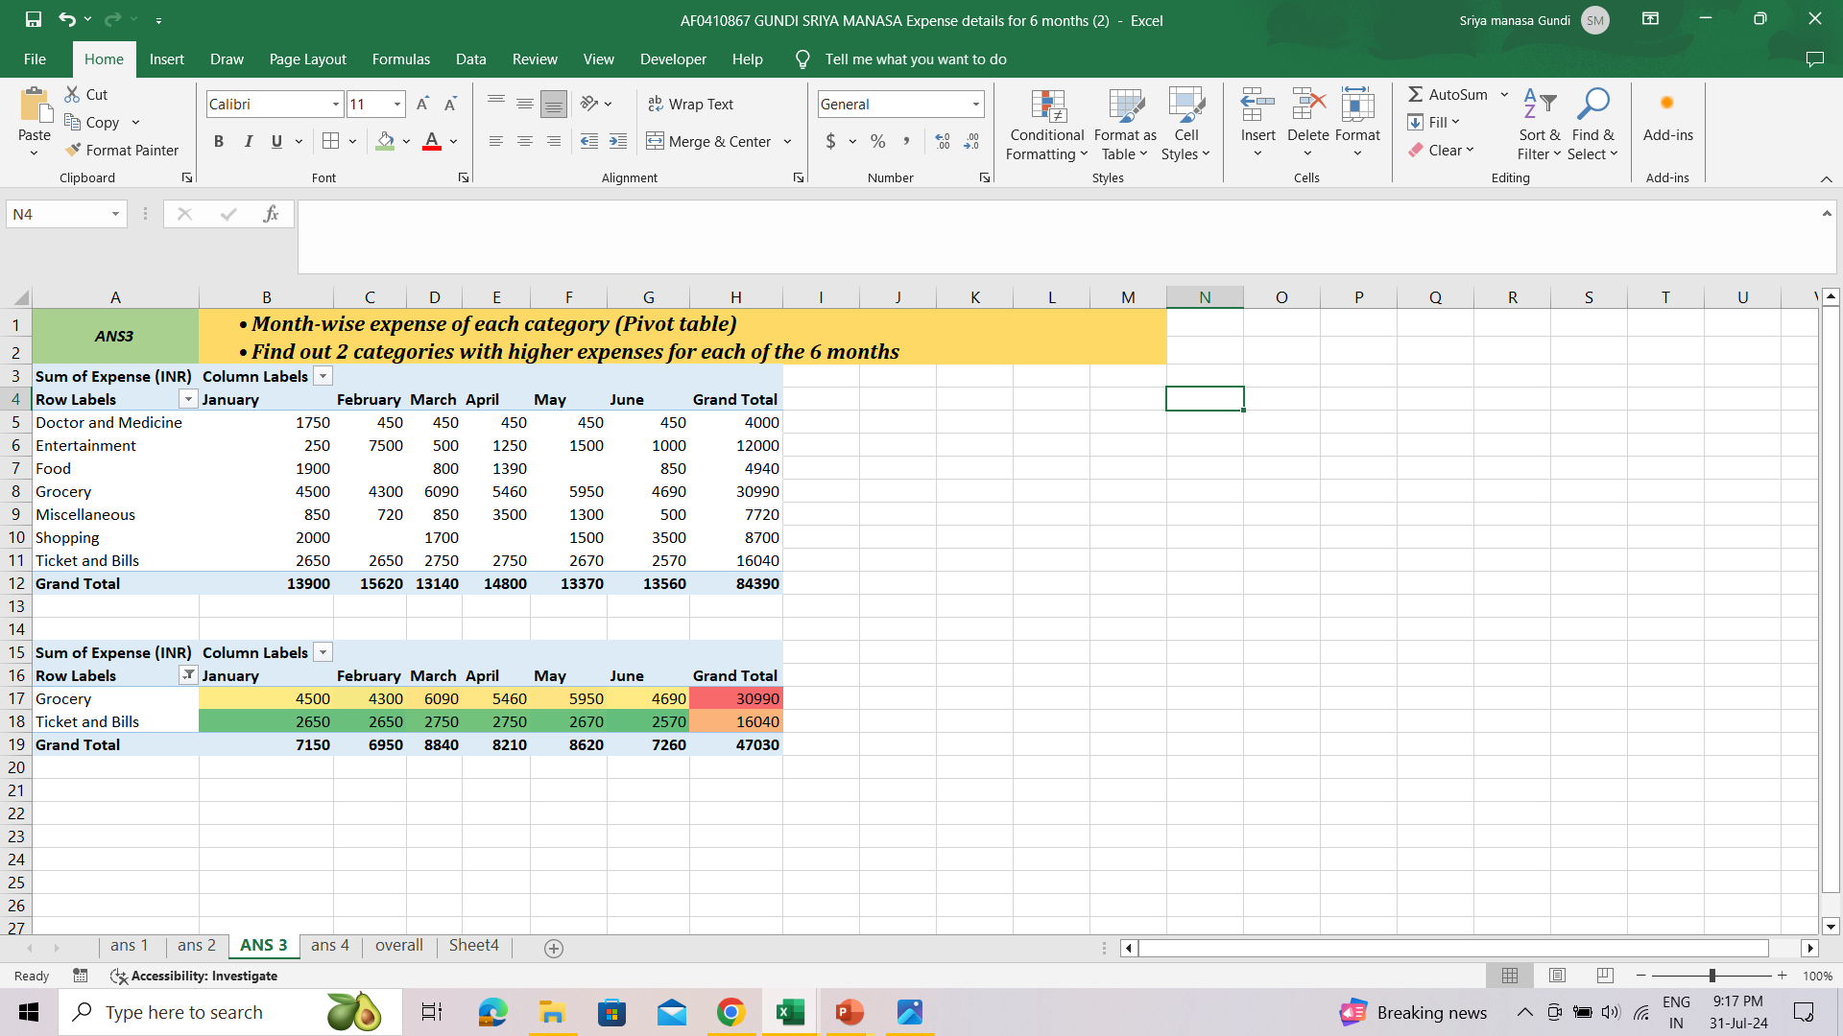
TASK 3
Member 3 | Month-wise expense of each category (Pivot table) Find out 2 categories with higher expenses for each of the 6 months

Slide 11
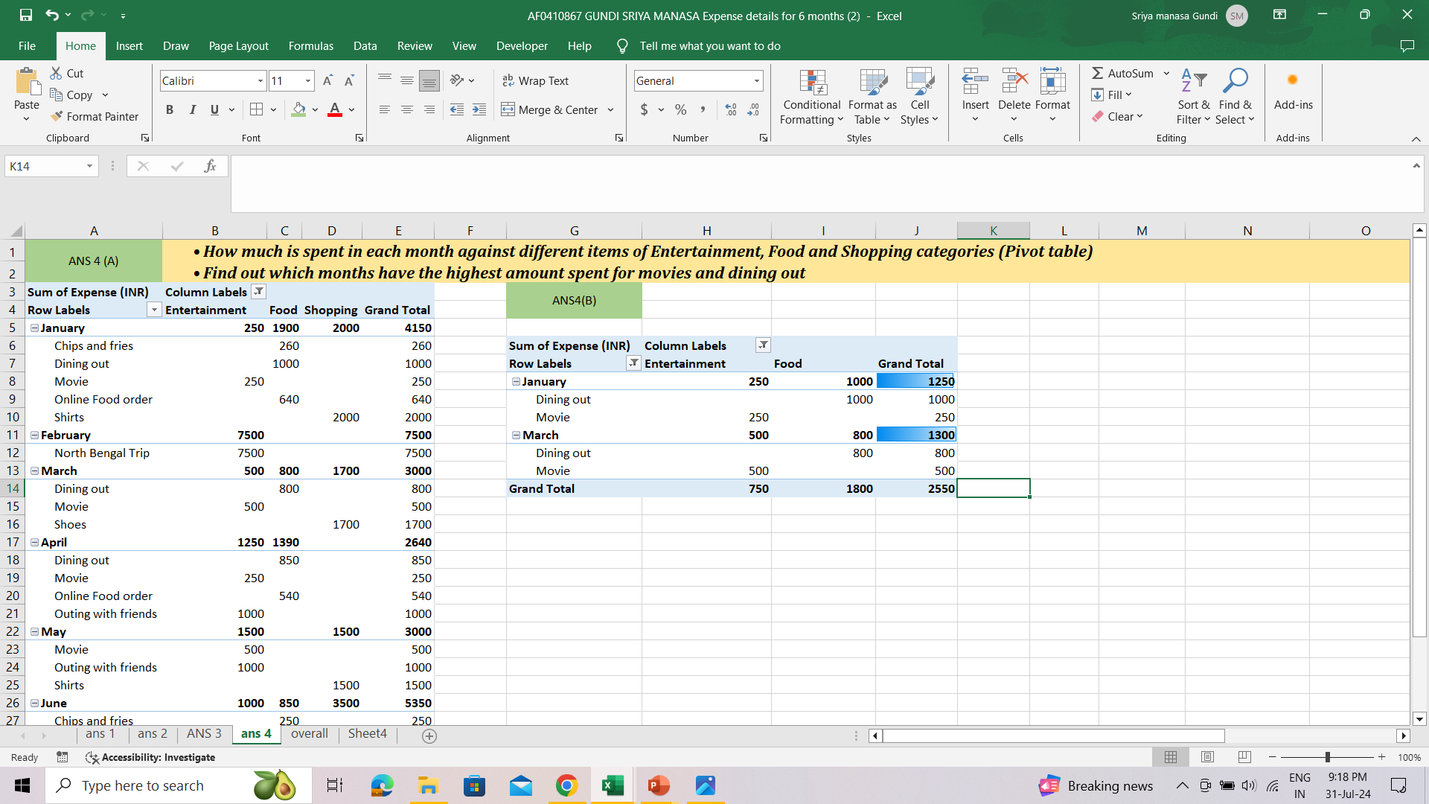
TASK 4
Member 4 | How much is spent in each month against different items of Entertainment, Food and Shopping categories (Pivot table) Find out which months have the highest amount spent for movies and dining out

Slide 12
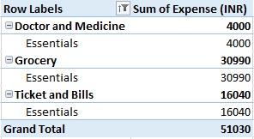
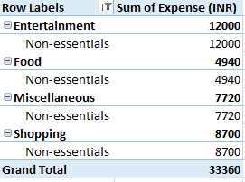
All | Decide on the essential and less essential items and analyse the expenses Recommend how can Nitin increase his savings
Essential Items category wise: Doctor and Medicine, Grocery, Ticket and Bills
Non-essential Items category wise: Entertainment, Food, Miscellaneous, Shopping

Slide 13
Recommendations for Increasing Nithin savings
1. Review and Reduce Non-Essential Spending
Entertainment: Limit movie outings and trips. Instead, consider more cost-effective leisure activities.
Shopping: Evaluate the need for clothing and accessories. Plan purchases and avoid impulse buys.
Miscellaneous: Track and control spending on non-essential items like gifts.
2. Monitor and Adjust Essential Expenses
Food: Reduce dining out and online food orders. Plan and prepare meals at home more often.
Grocery: Look for discounts and buy in bulk where possible. Avoid buying unnecessary snacks and beverages.
3. Optimize Utility Bills
Electricity: Implement energy-saving measures to reduce electricity bills.
4. Budget and Track Spending
Create a monthly budget and use tracking tools or apps to monitor expenses.
Set savings goals and review spending against these goals regularly.
5. Evaluate Subscription and Memberships
If there are any subscriptions or memberships (e.g., magazine, streaming services), assess their necessity and cancel those that are not essential.

